Slide 1


SAVEETHA SCHOOL OF ENGINEERING SAVEETHA INSTITUTE OF MEDICAL AND TECHNICAL SCIENCES
AIRLINE RESERVATION SYSTEM
CSA-0910
SUBMITTED BY
V.Ramayya(192210191)
K.Mahesh(192210024)
DEPARTEMENT OF CSE
SAVEETHA SCHOOL OF ENGINEERING SIMATS,CHENNAI-602105.
GUI DED BY
Dr. A. Ganesh Ramachandran
PROFESSOR
SAVEETHA SCHOOL OF ENGINEERING SIMATS,CHENNAI-602105.

Slide 2
Contents
▶ Abstract
▶ Introduction
▶ Software Requirements
▶ Existing
▶ Proposed
▶ Use Case Diagram
▶ Technology Used
▶ Output
▶ Conclusion
▶ Future Enhancement
▶ References

Slide 3
Abstract
The Airline Reservation System (ARS) is a comprehensive software solution designed to streamline the process of booking flights, managing reservations, and viewing passenger information. Implemented using Java Swing, the ARS provides an intuitive graphical user interface that enhances the user experience for both customers and airline staff. Key features of the system include a secure login mechanism, a robust flight search module, a seamless booking process, and an efficient way to manage passenger details.
The login dialog ensures that only authorized users can access the system, maintaining the integrity and security of sensitive data. The primary objective of the Airline Reservation System (ARS) is to create a secure, efficient, and user-friendly application for booking flights, managing reservations, and handling passenger information.
The flight search panel allows users to quickly and accurately find available flights based on their preferences and requirements. The booking panel guides users through the process of reserving seats, capturing essential passenger information and handling payment transactions. Finally, the passenger information panel enables staff to view and manage details of all passengers efficiently.

Slide 4
Introduction
In today's fast-paced world, the airline industry plays a crucial role in connecting people and places across the globe. Efficiently managing the complex processes of flight reservations, bookings, and passenger information is essential for both airlines and their customers. The Airline Reservation System (ARS) is designed to address these needs by providing a comprehensive, user-friendly software solution.
The ARS leverages Java Swing to create an intuitive graphical user interface, ensuring a seamless experience for users. It encompasses various modules that facilitate secure login, efficient flight search, smooth booking processes, and effective management of passenger details. This system aims to streamline airline operations and enhance customer satisfaction by making the reservation process straightforward and efficient.
This project demonstrates the practical application of Java in creating a real-world, user-centric application, showcasing the capabilities of modern software development techniques in addressing the specific challenges faced by the airline industry.

Slide 5
Software Requirements
JVM- This is basically a virtual machine that gives the runtime environment for execution of a java byte code. It does not understand any kind java typo, this why .java files are compiled in order to obtain the class file which further compiles into the byte code which can be understood by JVM. It has the control over every execution of every java program. It also has some features like garbage collected heap or automated exception handling.
JDK- JDK or Java Development Kit is basically a bridge of one of the platform of java, enterprise edition, or java platform. It also has a private form of JVM and few different resources in order to finish the full development of the java application. It is one of the most used SDK since the origin of java.
JRE- JRE or Java Runtime Environment, this is also called as java runtime. It is a set of tools for developing java applications, this is also a part of the java development kit. It also provides the user. This consists of- JVM, supporting files and core classes.

Slide 6
Existing work
In the realm of airline reservation systems, numerous software solutions have been developed to cater to the complex needs of the aviation industry.
Some of the systems have dominated the market for decades, offering comprehensive solutions for flight bookings, reservations, and passenger management.
Some existing systems may have basic automation for tasks like account opening, but they may lack advanced features such as online banking, real-time reporting, and analytics.
The primary objectives of the Airline Reservation System is to provide a user-friendly interface for both airline staff and customers, facilitating seamless interaction and transactions.

Slide 7
Proposed Work
Implementing a robust login system to ensure secure access for authorized users only, protecting sensitive passenger and operational data.
Developing a comprehensive search module that allows users to easily find flights based on criteria such as date, origin, destination, and class of service. The booking process will guide users through selecting flights, entering passenger details, and completing transactions seamlessly.
Providing airline staff with tools to manage passenger information effectively, including viewing, updating, and cancelling bookings as necessary. This includes maintaining accurate records of passenger details and travel histories.
Designing a user-friendly interface using Java Swing that ensures ease of navigation and clarity in presenting flight options, booking details, and passenger information. This interface will enhance user satisfaction and operational efficiency.
Architecting the system to be scalable, capable of handling increasing volumes of users and data over time without compromising performance. Ensuring high availability and reliability to minimize downtime and disruptions.
Adhering to industry standards and regulations regarding data privacy and security, implementing encryption protocols for sensitive data, and maintaining audit trails for accountability.

Slide 8
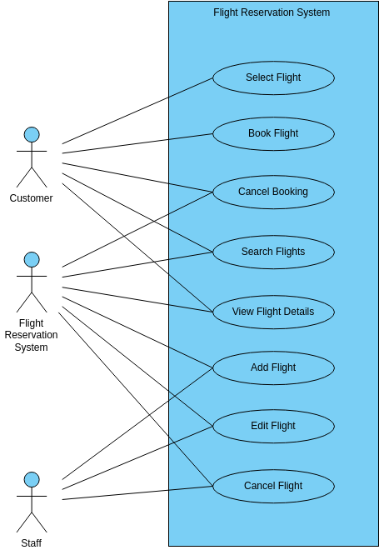
Use Case Diagram

Slide 9
Technology Used
JAVA- Java is a programming language which is simple in use but very powerful. It was started by sun micro-
systems in 1991. It is totally platform independent.
SWING- Swing is basically a widget GUI toolkit which is used for java. This is also a part of java foundation classes (jfc) by oracle– this provides a GUI for java programs. Swing was developed to provide a better as well as more sophisticated approach towards few set of basic components of GUI rather than earlier AWT (earlier abstract window toolkit). Swing provides more advanced components to the user such as scroll panes, trees, tabbed panels etc.
MY SQL- My-SQL is a very famous open source relation SQL also a database management system. It is one of the
best relational database management system used for developing various projects on web.
MULTI-THREADING- In this we can basically divide a program into smaller processes. Each of them can be classified as a single thread. For example- if some lightweight process acts as a CPU (virtual) which will execute your code or system calls. Users don’t usually have to worry about these lightweight processes to program with few threads. It contains more than one thread which can run concurrently and each thread defines a separate path for execution.

Slide 10
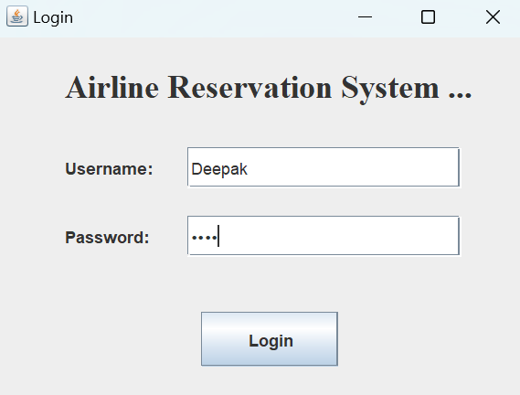
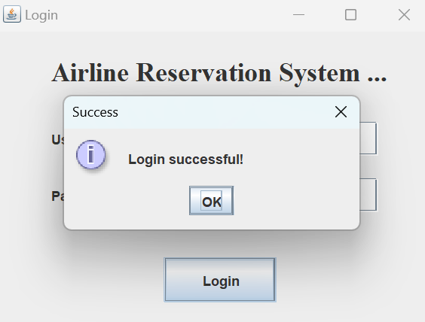
Output

Slide 11
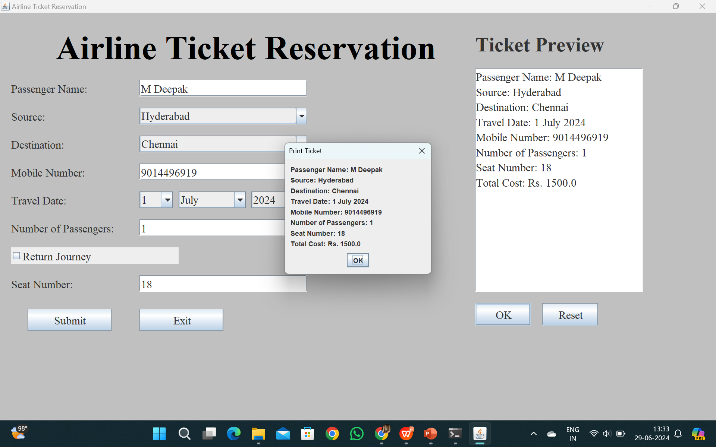

Slide 12
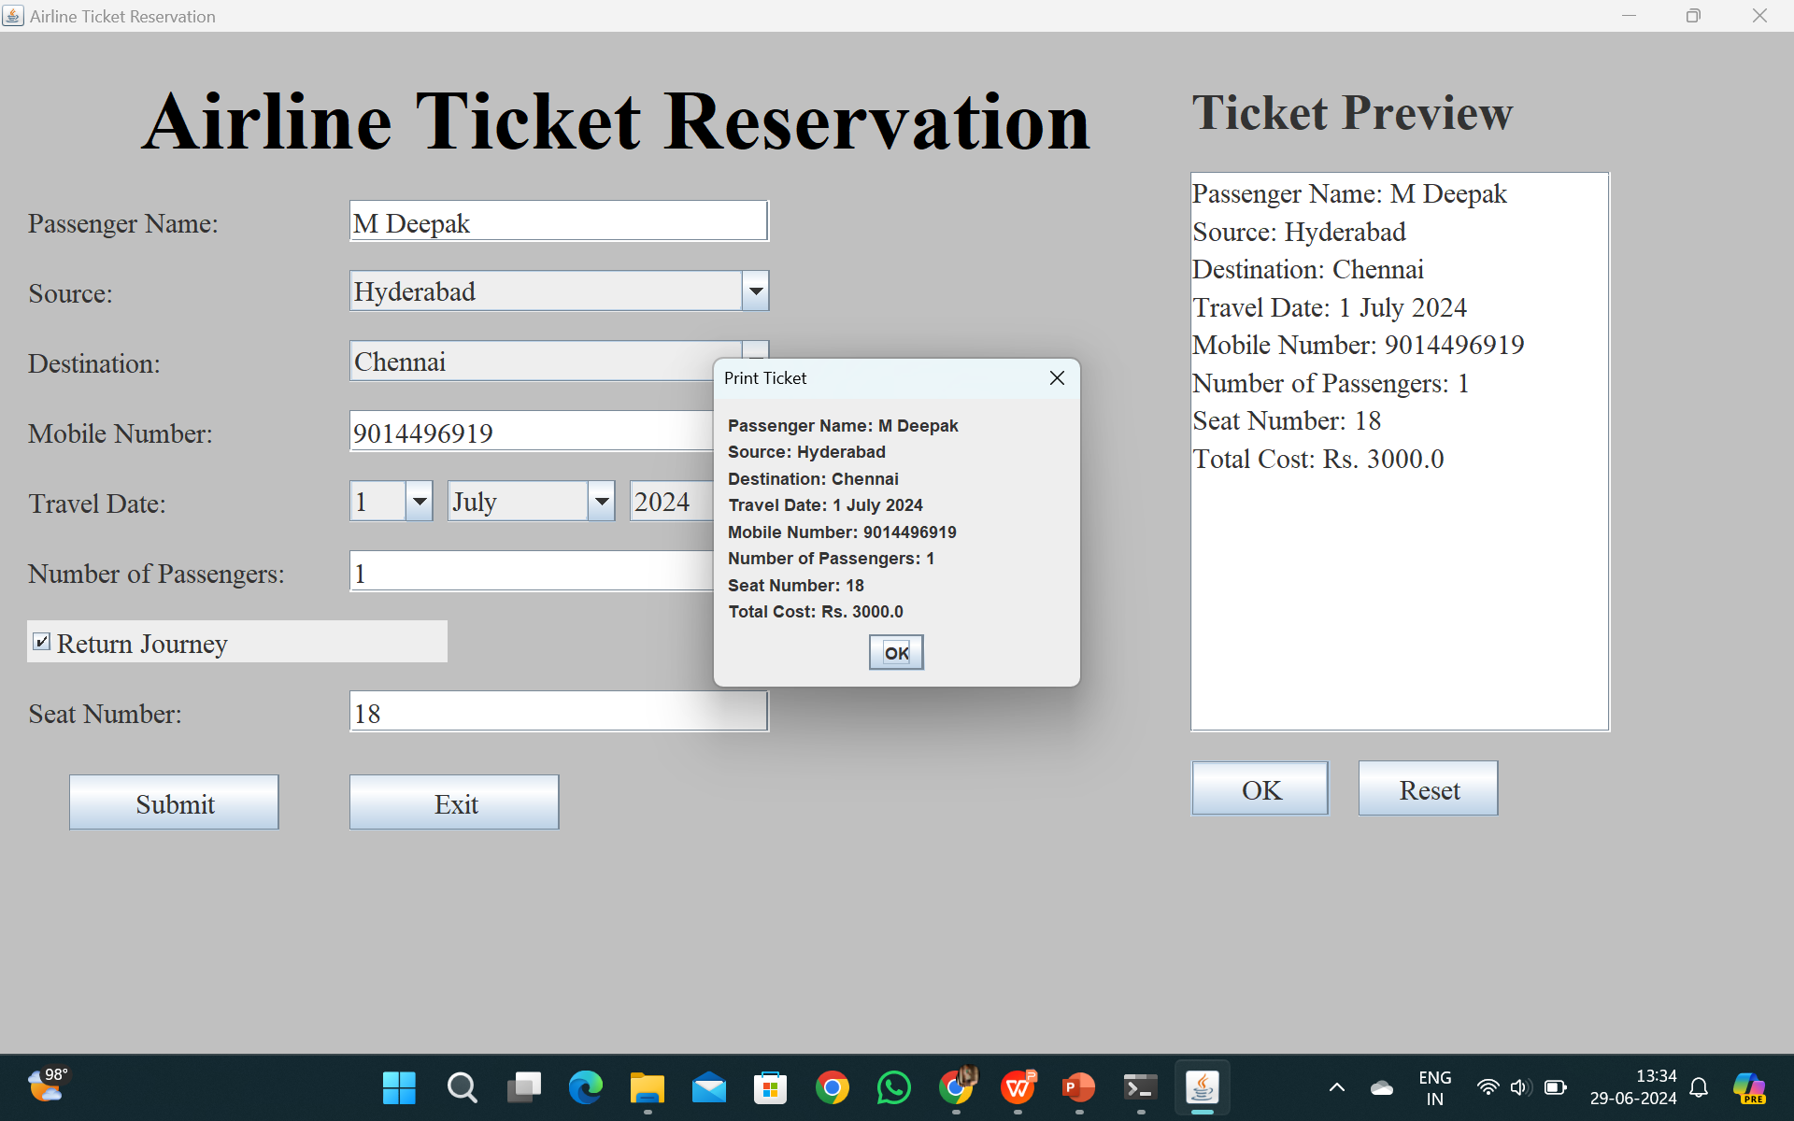

Slide 13
Conclusion
In conclusion, the development of the Airline Reservation System (ARS) using Java Swing represents a commitment to leveraging robust technologies to meet the evolving needs of the airline industry.
By adopting Java as the core programming language and Java Swing for the graphical user interface, the ARS ensures platform independence and a consistent user experience across different environments.
Looking forward, the ARS is poised to deliver a comprehensive solution that not only meets current operational requirements but also adapts to future technological advancements and scalability needs.
Through continuous improvement and adherence to best practices in software development, the ARS strives to contribute positively to the efficiency, reliability, and customer satisfaction within the airline industry.

Slide 14
Future Enhancement
The Airline Reservation System (ARS) can be further enhanced to meet future demands and technological advancements in the airline industry. Key areas for enhancement include:
Mobile Compatibility: Developing a mobile version of the ARS to cater to the increasing number of users accessing services via smartphones and tablets.
Advanced Analytics and Reporting: This would enable airlines to make data-driven decisions to optimize routes, pricing strategies, and resource allocation.
Artificial Intelligence (AI) Integration: Incorporating AI can streamline customer support and enhance interaction efficiency.
Enhanced Security Measures: Continuously improving security measures to protect against cyber threats and ensure compliance with evolving data privacy regulations.

Slide 15
References
Airline, 2012 http://www.enotes.com/topic/Airline_Reservations_System retrieved on 23. May 2012
C. Winston, S. Morrison (2005): "The Evolution of the Airline Industry", Brookings Institution Press, South Dakota, Cf. p. 61-62, Computer Reservation Systems.
M. J. Smith (2002): “The Airline Encyclopedia, 1909 – 2000”. Scarecrow Press, New York.
R. Doganis, C. Routledge (2001): “The Airline Business in the 21st Century.” McGrawHill, New York.
R. Doganis, C. Routledge (2002): “Flying Off Course: The Economics of International Airlines,” 3rd Edition. McGraw-Hill, New York.
R. E. G. Davies (2014): “A History of the World’s Airlines”. Oxford University Press, London.
Reservation Interface (2012), http://www.asppms.com/autoclerk/Products/Interfaces/Reservation Interfaces/InterfacetoGDS.aspx .
Wardell, David J, "Airline Reservation Systems", 2022. Research paper.
Wikipedia (2012), http://en.wikipedia.org/wiki/Computer_reservations_system accessed on May 26, 2012 .
Winston, Clifford, 2024 "The Evolution of the Airline Industry", Brookings Institution Press, ISBN 081575843X. Cf. p.61-62, Computer Reservation Systems.

Slide 16

Airline Reservation System

